Slide 1

Using FME to inform Flood Risk Modelling
Harry Gibson
FME World Tour 2014 - London

Slide 2
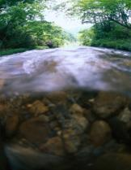
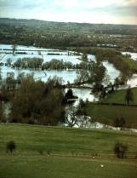
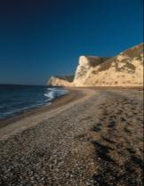
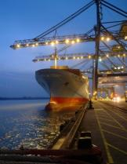
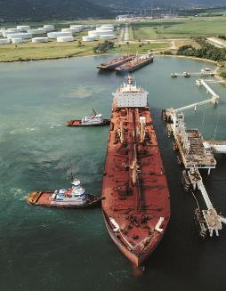
Introduction to HR Wallingford
Independent international research and consultancy organisation in civil engineering and environmental hydraulics…
Water
Floods
Coasts
Maritime
Energy

Slide 3
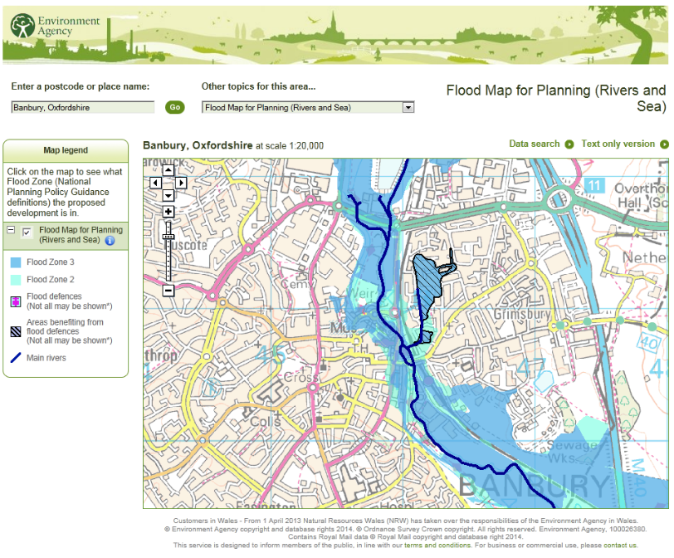
Strategic flood risk assessment
Flood risk models assess the likelihood of flooding in any given year and take into consideration the presence and performance of defences
This map is an output of NaFRA – the National Flood Risk Assessment (not a map of any one particular flood – but contours of equal likelihood)
How are these produced?
Risk = likelihood x consequence

Slide 4
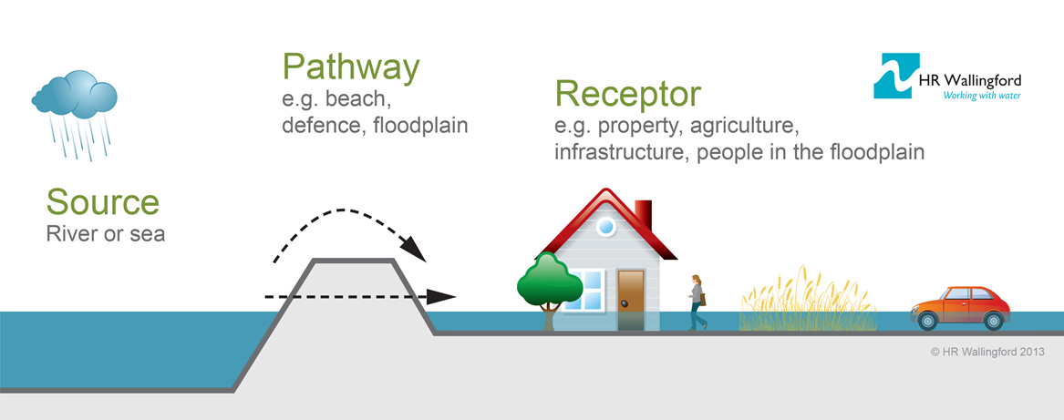
Modelling concept
A Source – Pathway – Receptor model is used.
Sources are where the water “comes from” – the river or sea
Pathway is what the water has to pass over to reach the receptors – the river bank, coastline, or flood defences and the floodplain
Receptor is the things that get flooded! Buildings, roads, infrastructure, agriculture…
Each part of the system is modelled separately
Combining the models allows us to assess flood risk
Notes:
RASP = Risk Assessment for Strategic Planning

Slide 5
Our problem: The Pathway
The pathway is a continuous line between sources and receptors BUT
Not every river has flood defences all along it
Not all defence datasets match up, and in turn they don’t necessarily tie into data from other sources
So to make a continuous defence line there is a laborious, involved GIS editing process of matching and merging lines, choosing which to use, and transferring attributes
Notes:
RASP = Risk Assessment for Strategic Planning

Slide 6
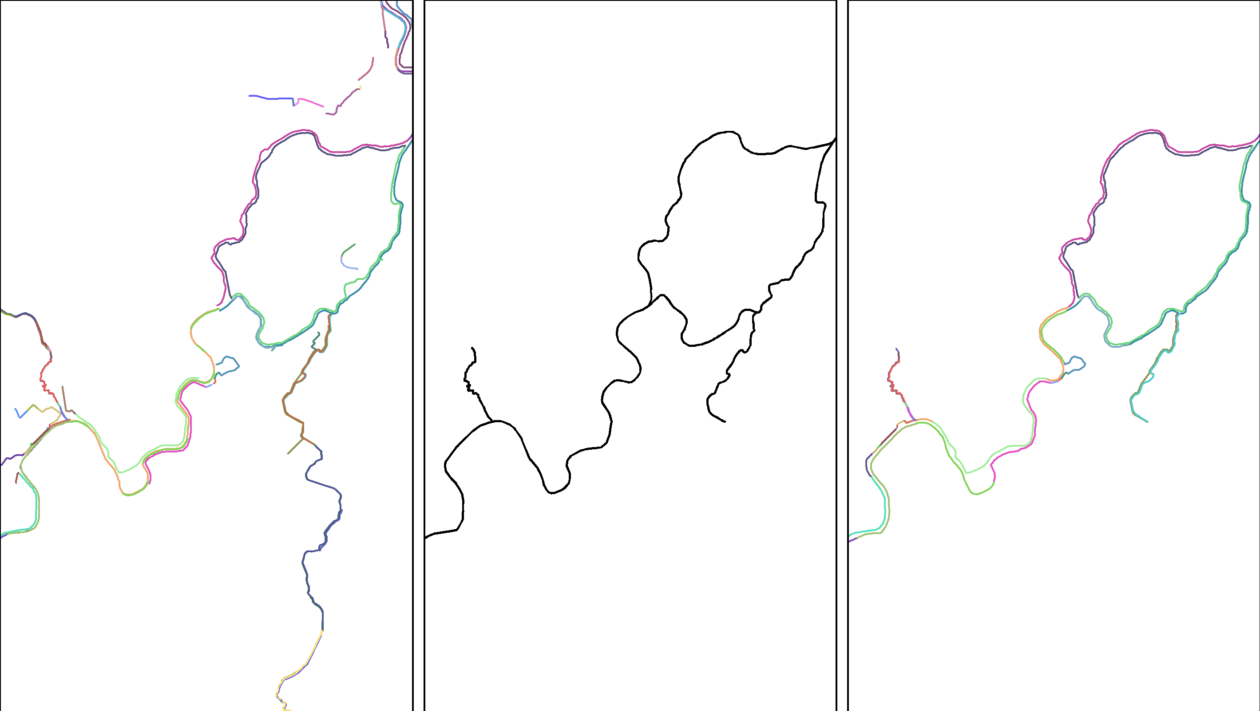
The manual editing process
Flood defence data are discontinuous or do not match river geometry
The user must edit the geometry and attributes of this to incorporate the flood defences…
A fixed width buffer is produced around the rivers
…whilst maintaining the continuity of the line where there are no defences, and preferably picking a sensible location manually

Slide 7
The manual editing process
The datasets must be manually combined
A fixed width buffer (“Tramline”) is produced
The user must edit this to incorporate the attributes and geometry of the defences
Where there are no defences the only option is the fixed-width buffer (or digitising from user knowledge and interpretation of maps – for example the river bank)
It takes AGES!
Often well over half the total modelling time
Needs users who are expert in desktop GIS as well as being flood modellers

Slide 8
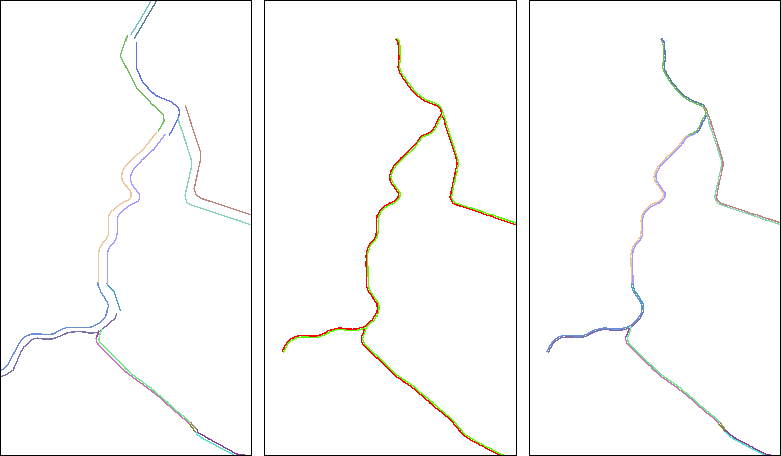
The manual editing process
Because of this it’s not unheard of for shortcuts to be taken…
…such as just mapping the defence attributes onto the tramline and discarding their geometry

Slide 9
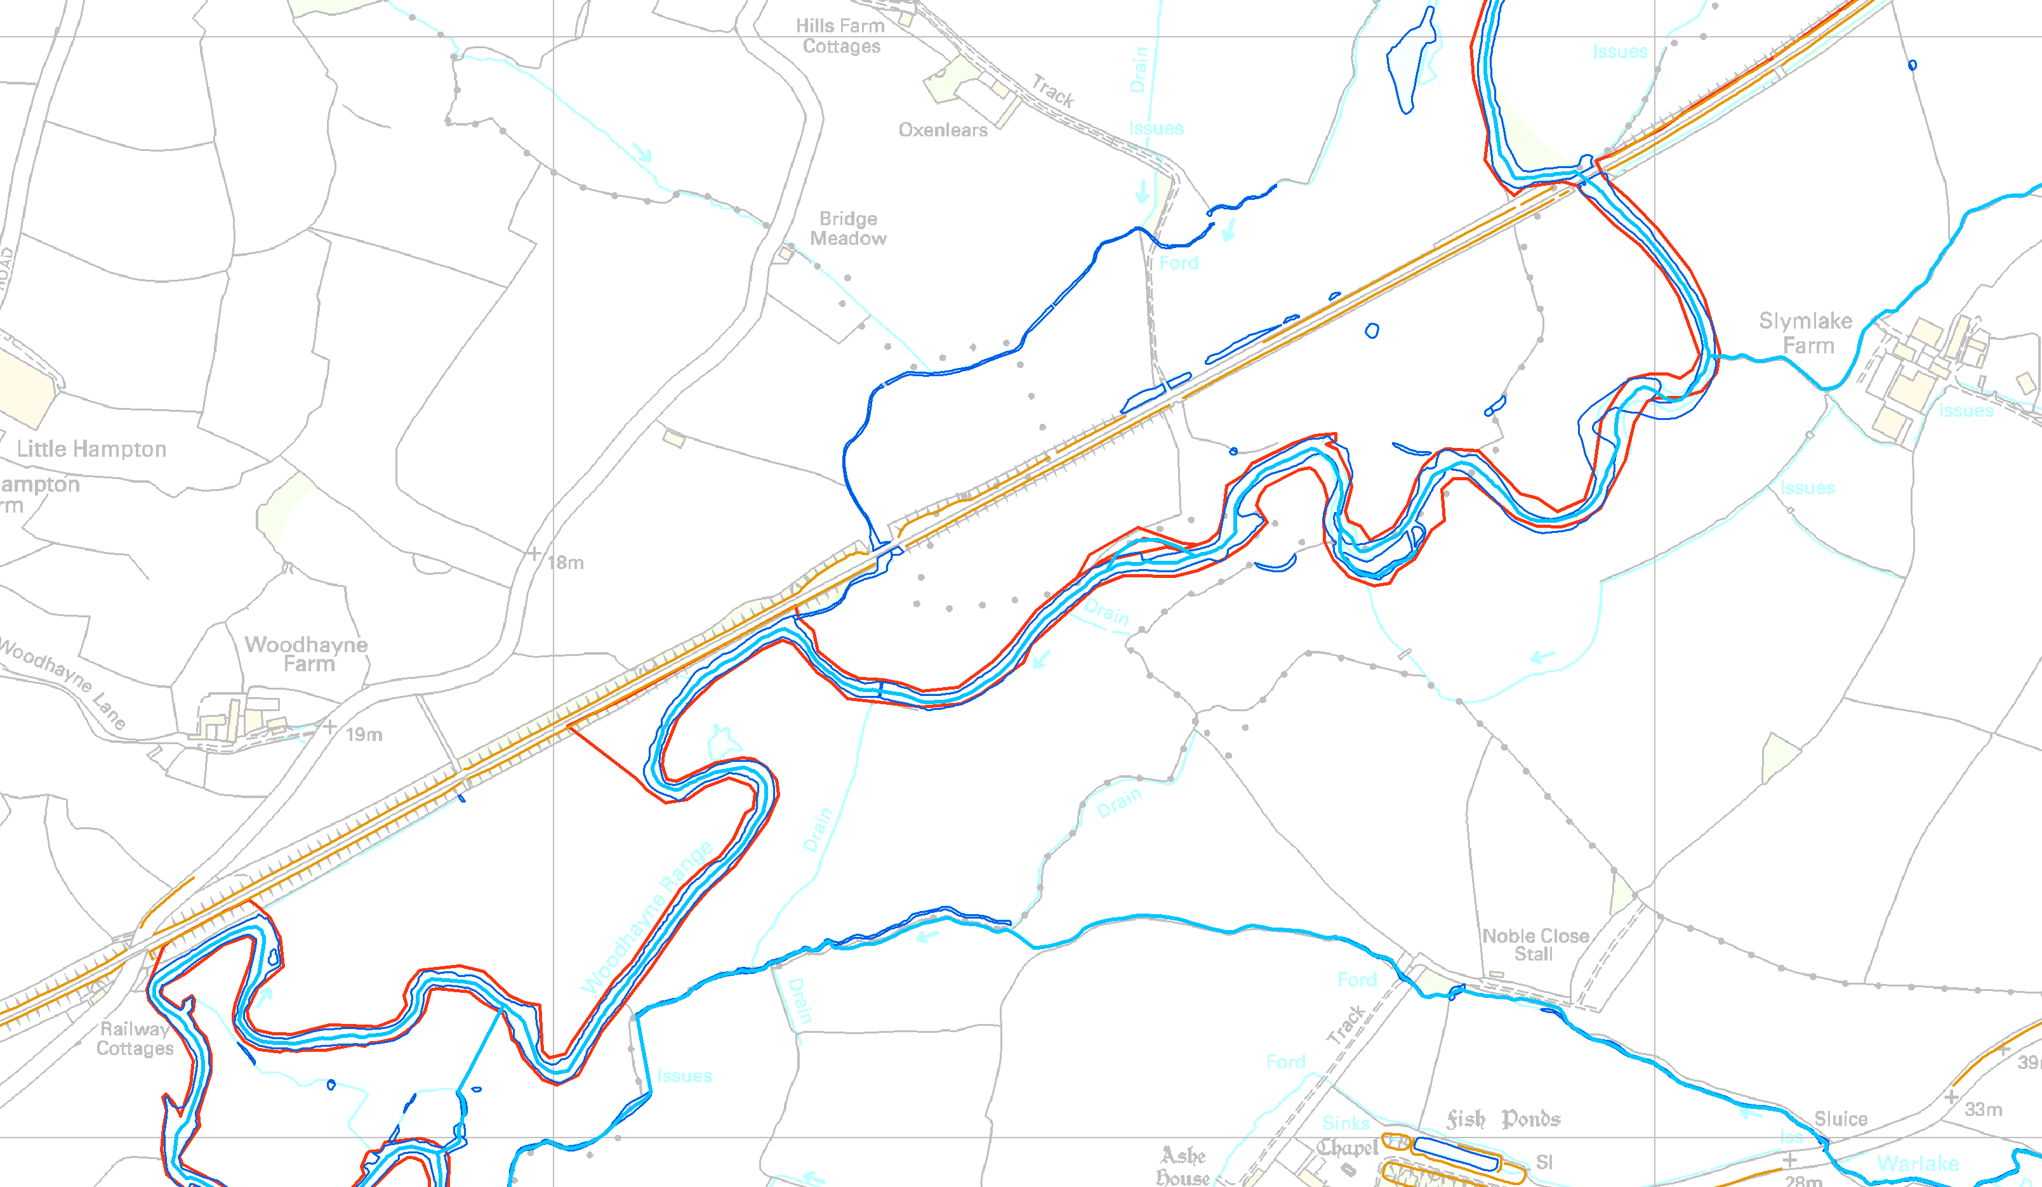
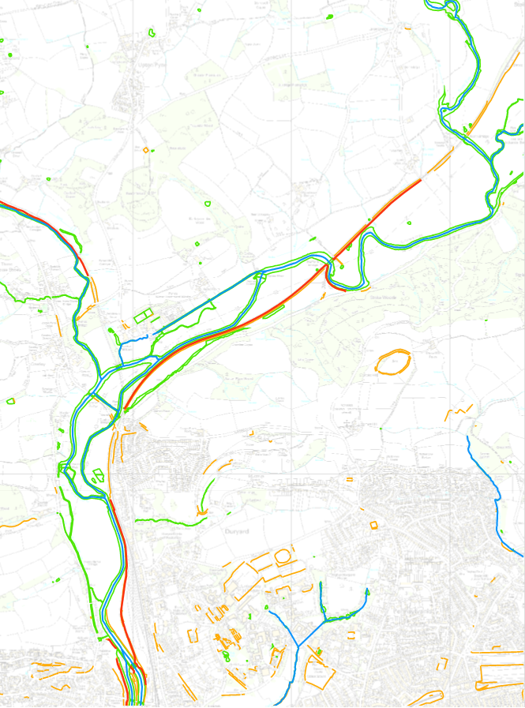
Other datasets could provide “options” for the CDL path
In areas where there are no flood defences, we can still do better than a fixed width line.
OS Mastermap tells us about slopes and riverbanks; we have a shoreline dataset…
Taken together these give a range of possible options
But there is too much so we need to select the right bits

Slide 10
Automation: specify the problem
Need a continuous line along each side of each river, and the coast
Line should follow the raised defences where possible
Elsewhere we want some intelligent best guess of the effective “defence line” – i.e. the flood boundary
We might get this from embankments / slopes, shown in Mastermap
We might get this from the bank of rivers / lakes, shown in Mastermap
Each line must be continuous – no gaps – so we need to fill in areas where even Mastermap doesn’t provide a suitable line (e.g. single line watercourse)
We might use a traditional “fixed tramline” as a last resort if other data don’t exist
The input lines must all be connected to join the gaps between different datasets
The fluvial parts of the line must be referenced to the river segments
And all this must be produced automatically as far as is possible!

Slide 11
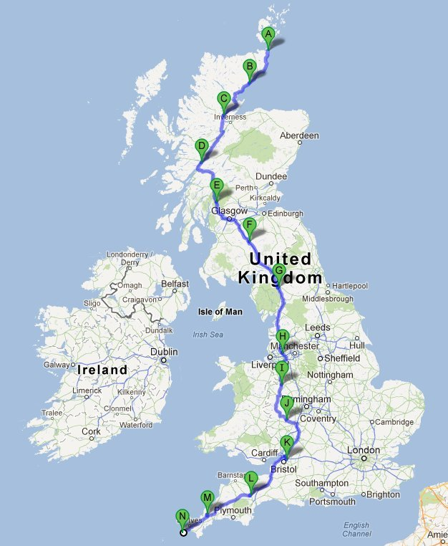
How do we identify the route?
How do we combine these datasets automatically?
We can work out the GIS pre-processing we need for each dataset to make sure they are compatible
It’s complex but made of simple spatial operations: clips, intersections, nearest neighbours
But picking which line to use is harder: how do we tell FME to use flood defences when it can, but banklines otherwise?
So let’s turn this into a problem somebody clever has already solved

Slide 12
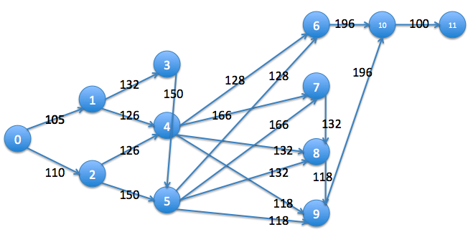
Diversion: TomTom’s Dijkstra’s Algorithm
The fundamental task performed by a satnav is finding the “shortest” route across a “graph” (a connected network of lines and nodes)
(where “shortest” = least cost by a particular metric that may be distance, or may equally be shortest time taken, highest number of pubs passed, whatever)
This is done using “Dijkstra’s Algorithm” (or a variant)
A satnav weights different edges (roads) differently depending on their type and the chosen metric… it prioritises them to choose the best route
Hmm… This sounds a familiar problem.

Slide 13
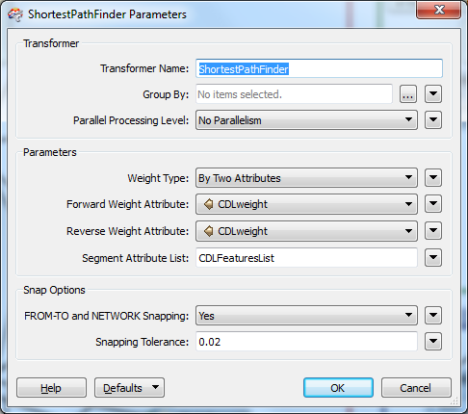
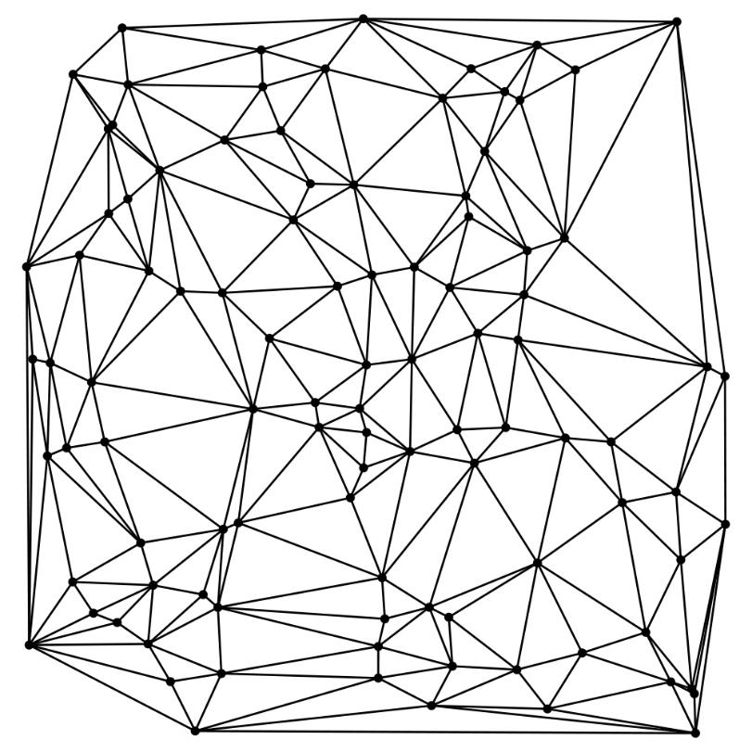
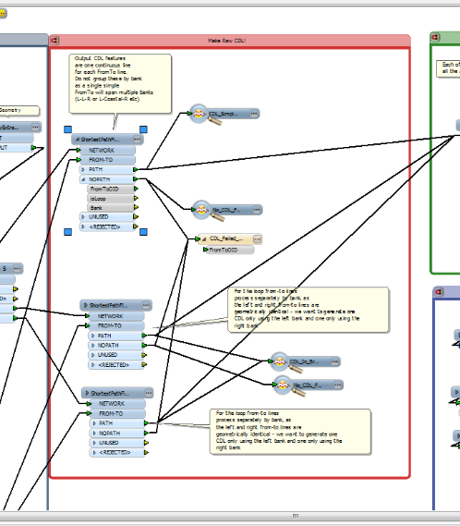
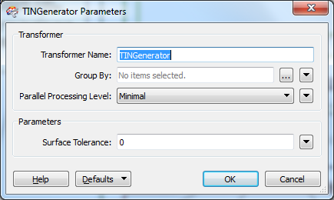
Shoehorning the idea into place
We effectively use a satnav to find the CDL.
AIMS defences are the “motorway”. Everything else is also prioritised according to how keen we are to use it.
Oh and by the way, FME is a satnav
There’s one more problem: the lines must all be connected. How can we do this?
Creating a mesh or “TIN” from points is a standard GIS operation for generating surfaces
But, Delaunay Triangulation has another relevant property: it connects points in such a way that a connected graph is guaranteed

Slide 14
The solution
So it turns out that FME can do every part of the processing!
Pre-process each dataset, in order of priority:
Rivers first -> flood defences -> Mastermap embankments and slopes -> Mastermap bank lines -> notional “tramline”
Lower priority data gets modified to match up with higher priority data
Processing steps for each dataset:
Modify geometry where necessary to ensure no intersections / crossings with river or each other
Allocate flood area (hydrologically independent units) for group processing
Each feature allocated to a particular river reach (or coastal)
Each feature correctly attributed to left or right bank, or coastal
Lower priority data “cut” near the endpoints of higher priority data
Ensure at least one candidate line always exists for all rivers – a fixed width buffer – in case there are no better choices

Slide 15
The solution
So it turns out that FME can do every part of the processing!
Connect them all together into a network dataset
Use a Delaunay triangulation giving a connected graph for each flood area
Remove edges that cross existing features
Weight each “edge” in the graph – i.e. every feature – according to its data source and length
Prioritise raised defences over Mastermap banklines, etc.
Longer defences = LOWER weight
Identify “start” and “end” locations, and use ShortestPathFinder to pick the “best” path along the river at all points
To maximise use of the higher quality data
Review the results, and if necessary adjust weights and re-run ShortestPathFinder

Slide 16
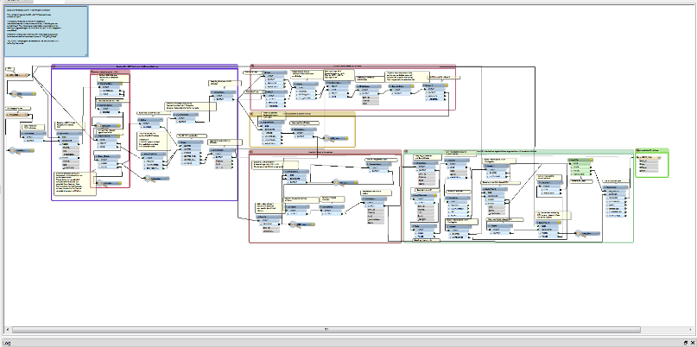
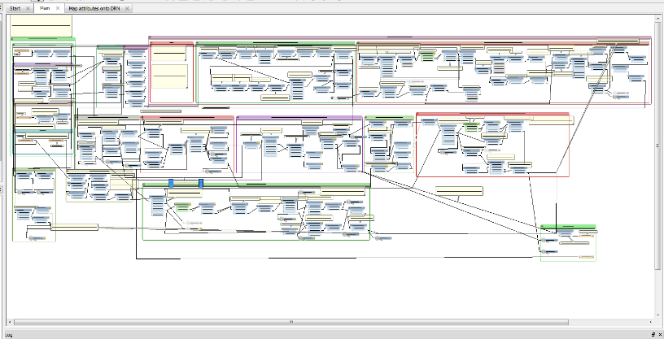
The overall workflow
The processing workflow is implemented in ten workbenches in FME 2013.
The time-consuming but less subjective bits happen first
The final route selection happens last
This allows user to make edits to the CDL without physically editing features – minimal GIS expertise
The workbenches are each called in turn with WorkspaceRunners from an overall workbench.
The process can be restarted at any point
Spaghetti code?

Slide 17
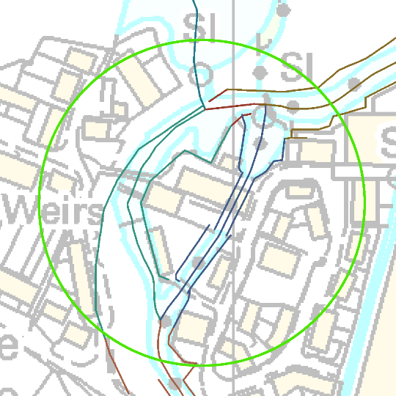
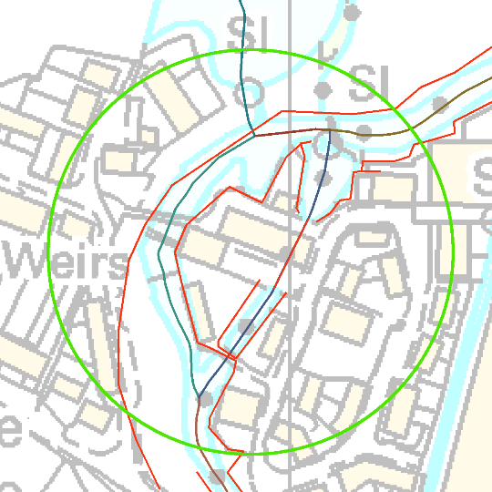
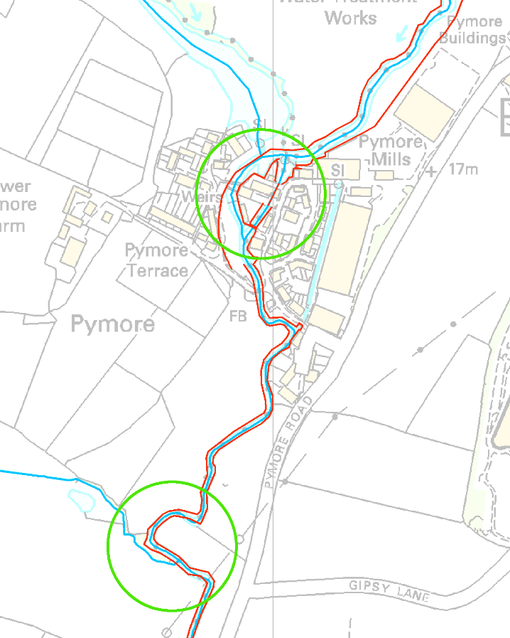
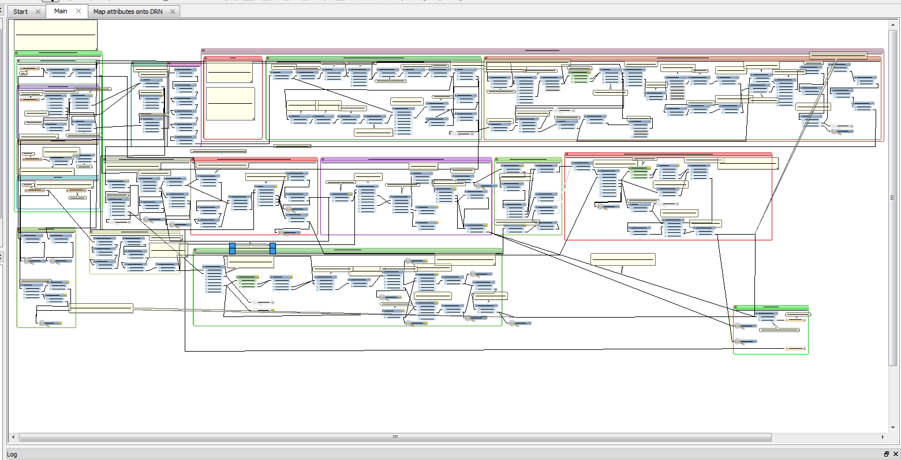
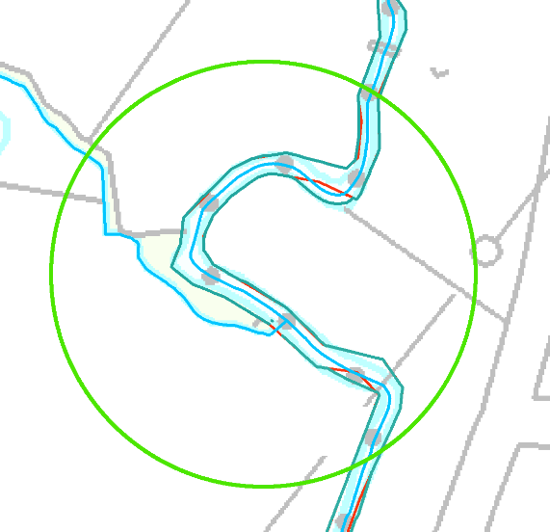
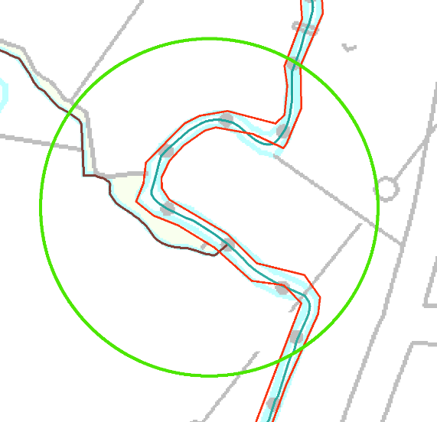
Pre-process all the “candidate” datasets - AIMS

Slide 18
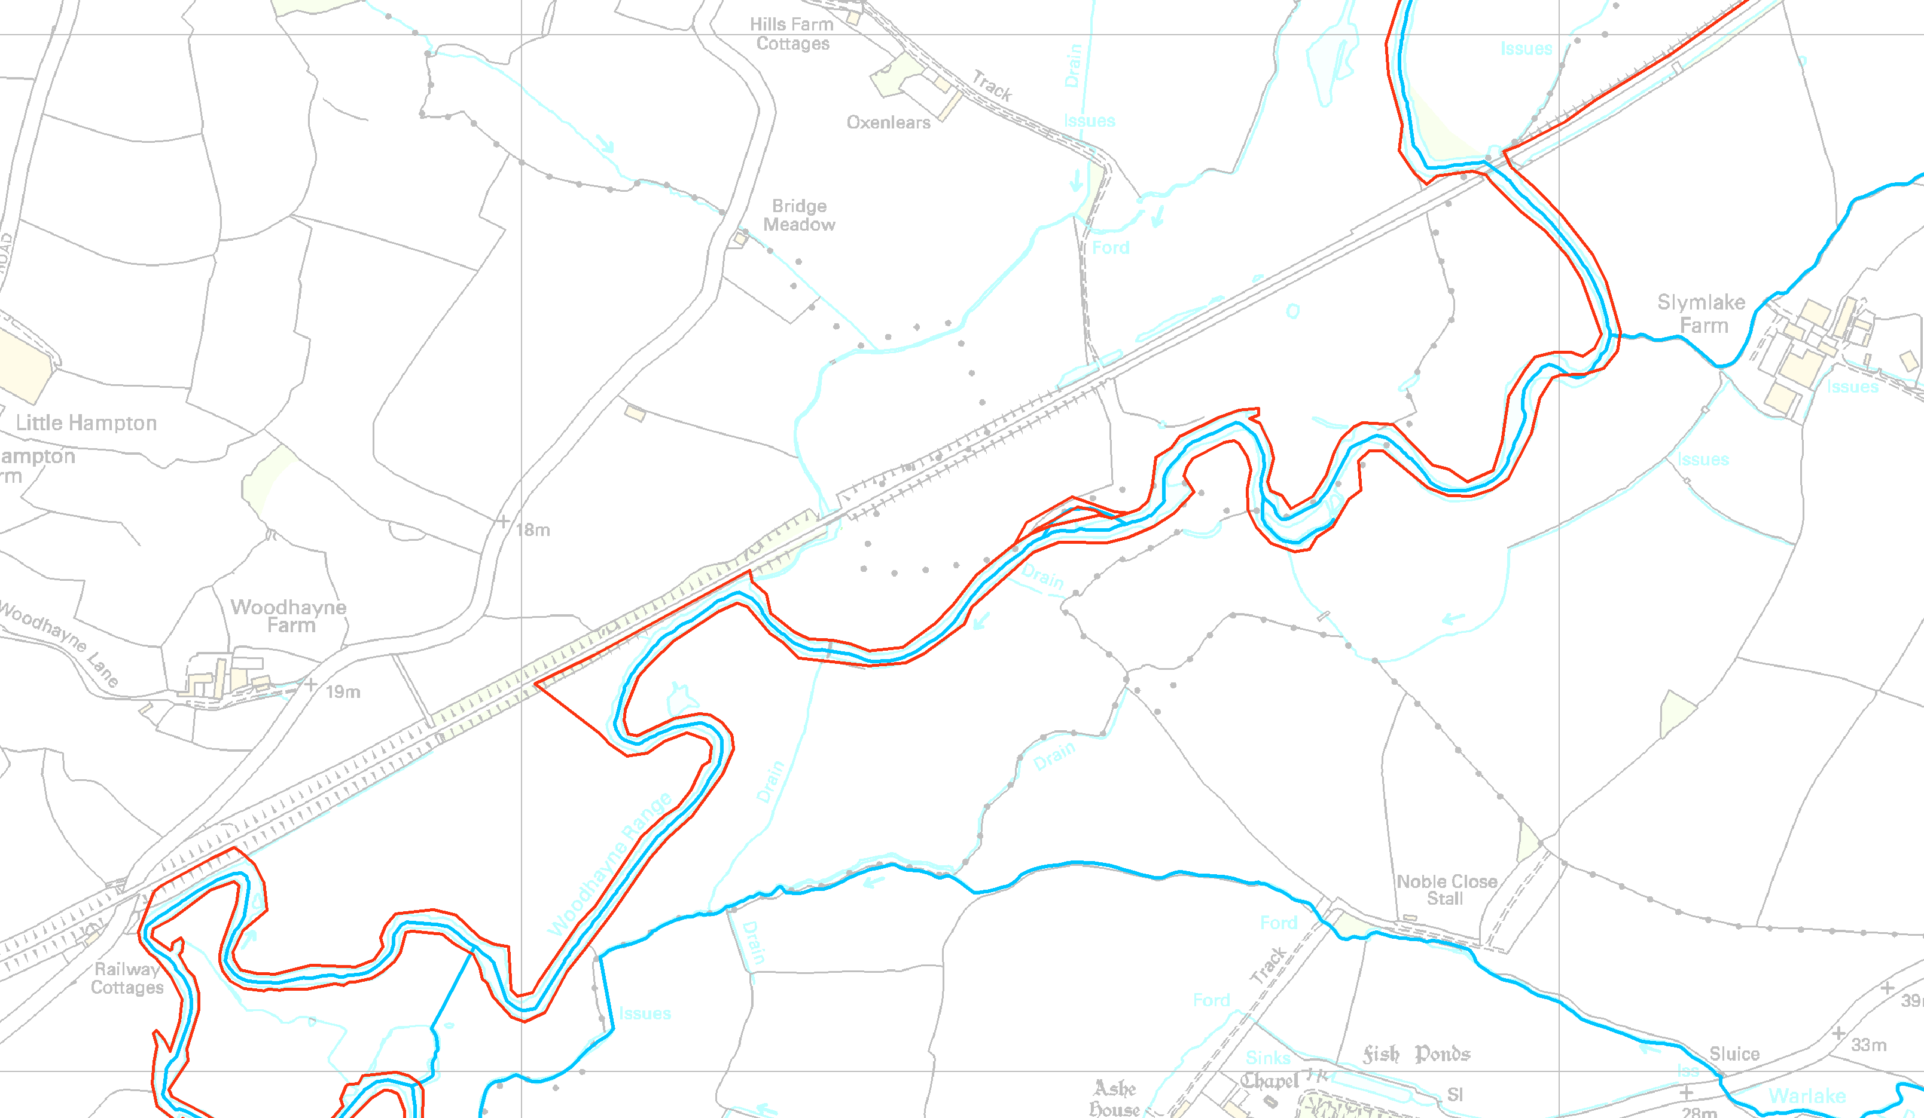
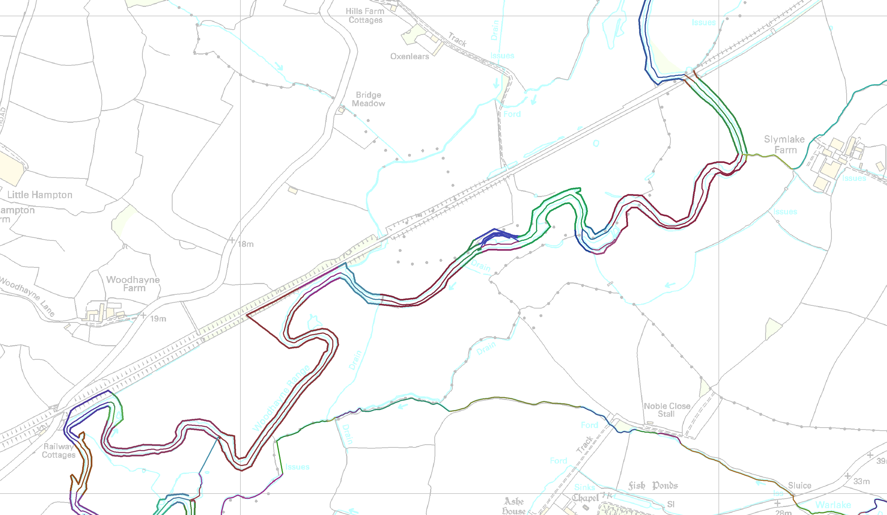
Allocate each piece to the river (or coast) it “defends”
Matching features to river reaches.
They may or may not intersect.
They may or may not match cleanly – one to many, or many to one, or none at all.
We can’t use any straightforward spatial relationships! (Certainly not just “closest”)

Slide 19
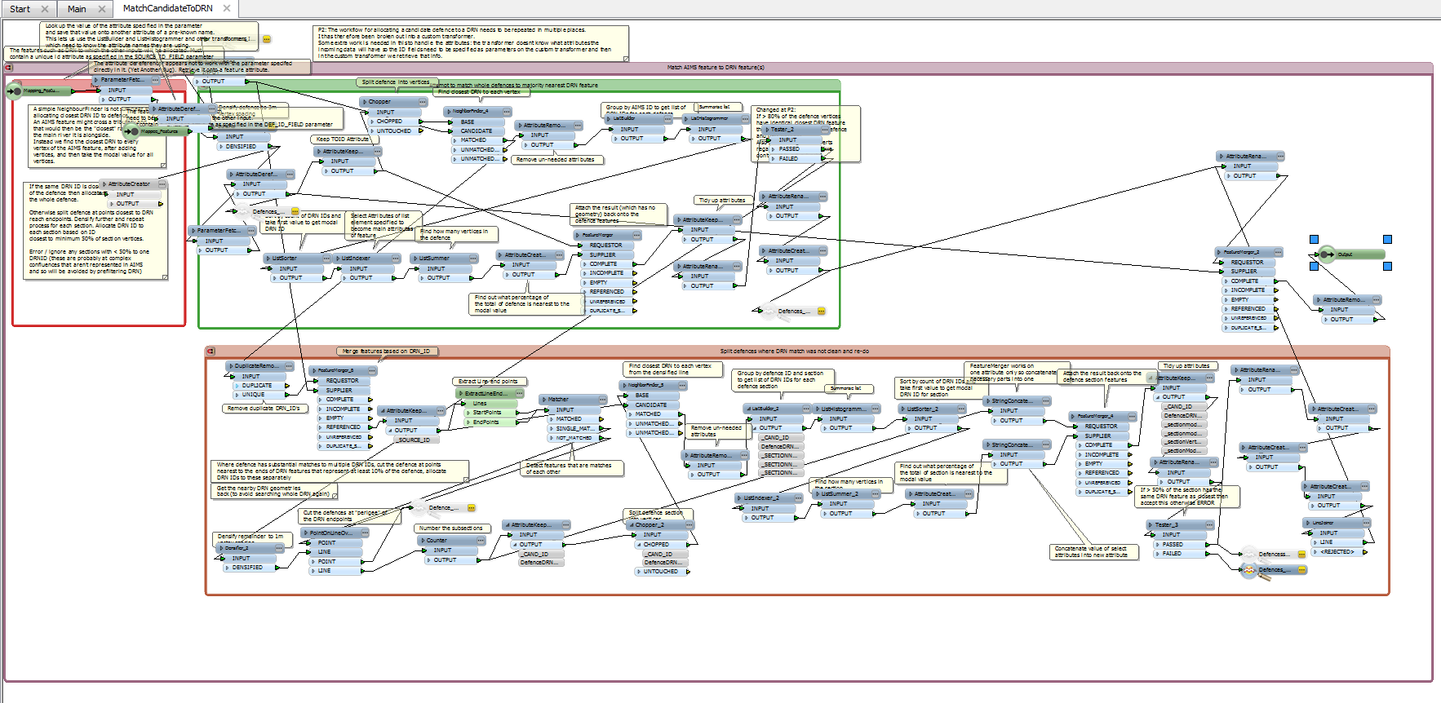
Feature matching detail
If more than a given percentage match, we allocate that river to the whole line
If not, we chop the line at the locations nearest to the ends of river reaches in the vicinity, densify these further, and try again
Using PointOnLineOverlayer with a tolerance to cut the lines
We densify the lines (rivers and defences) to a given vertex spacing
We match each vertex to the nearest river
We summarise the matches for each original line
Using ListBuilder, ListHistogrammer, and ListSummer
We use this in many places, so it is encapsulated in a custom transformer
This is a robust method of matching one line dataset to another where they are e.g. generalised to different extents

Slide 20
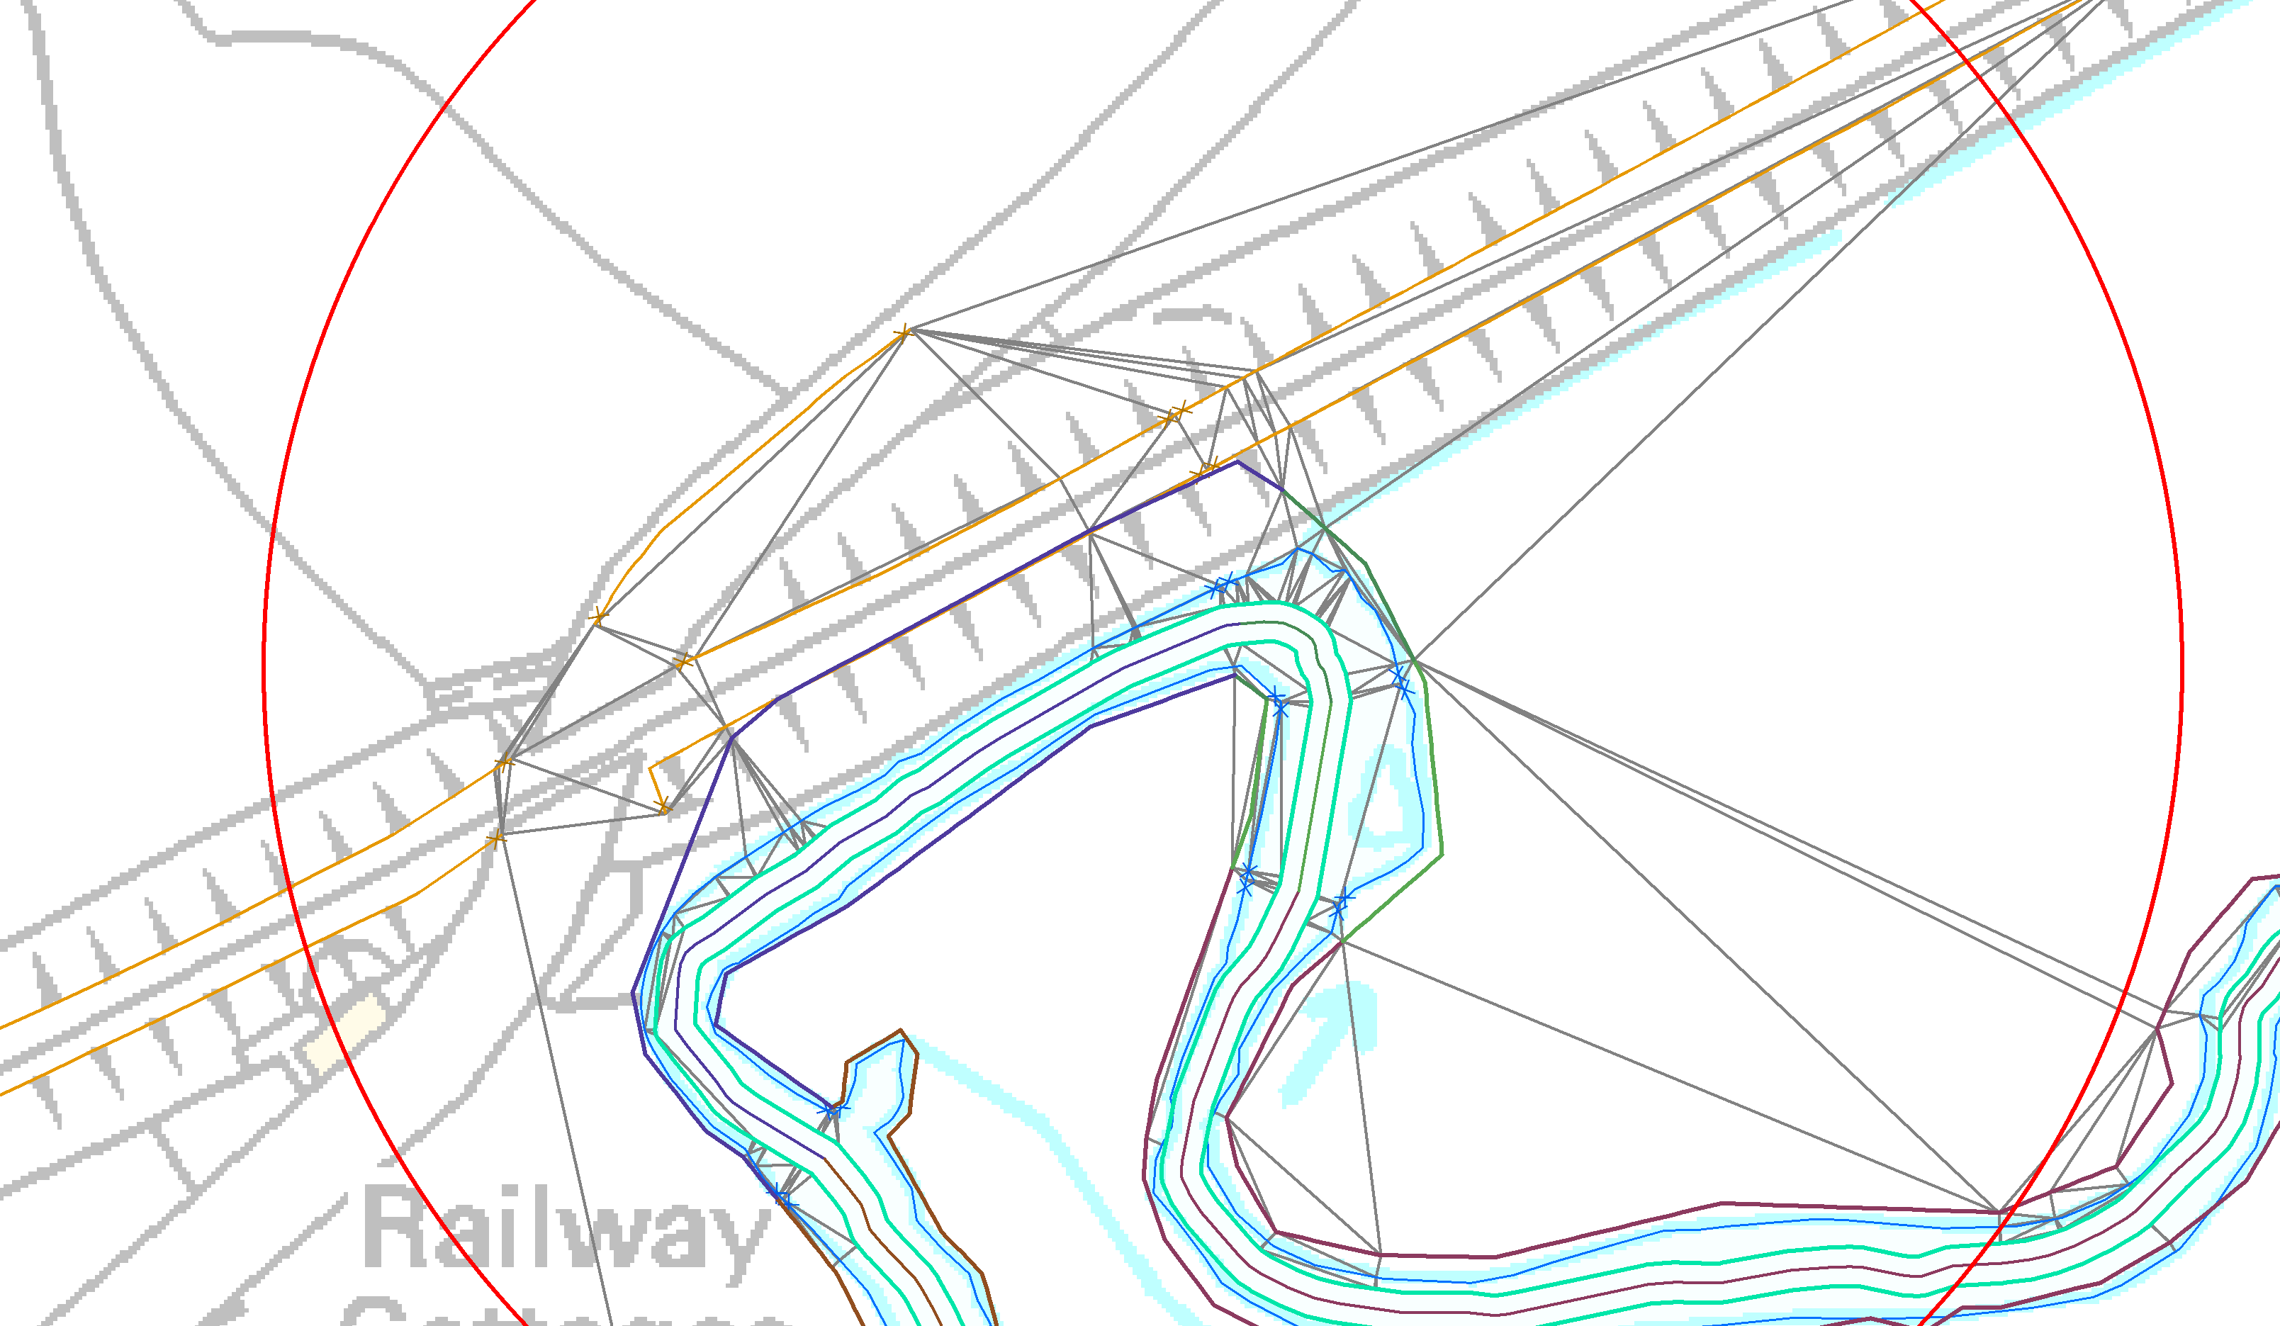
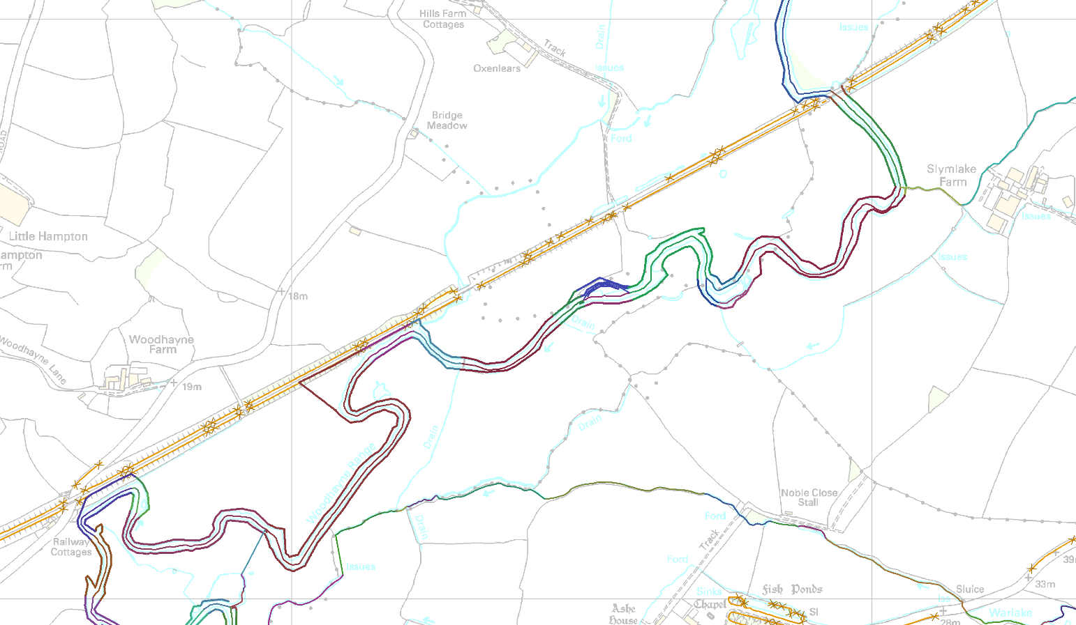
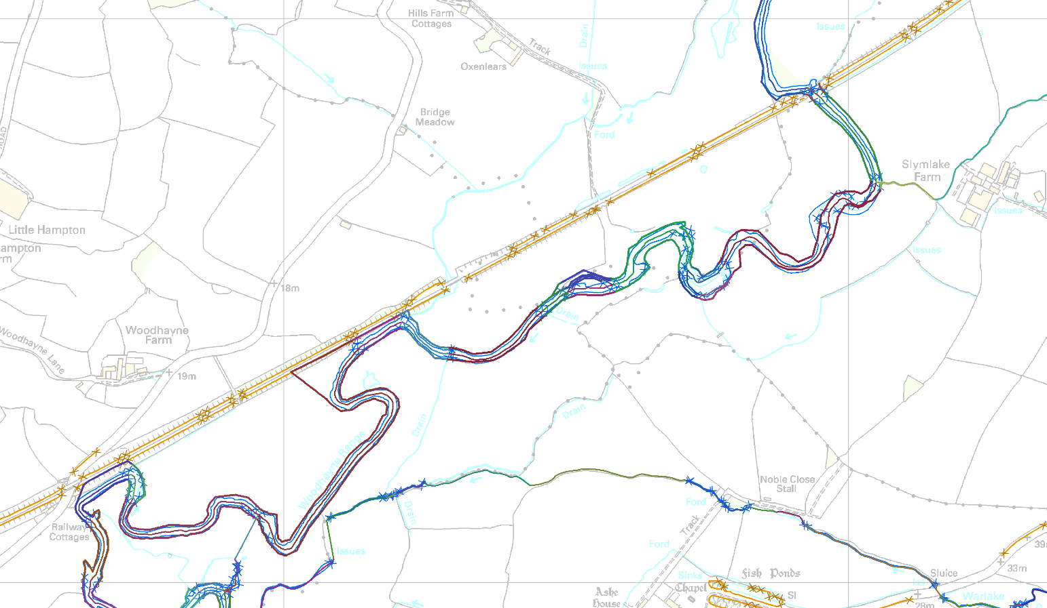
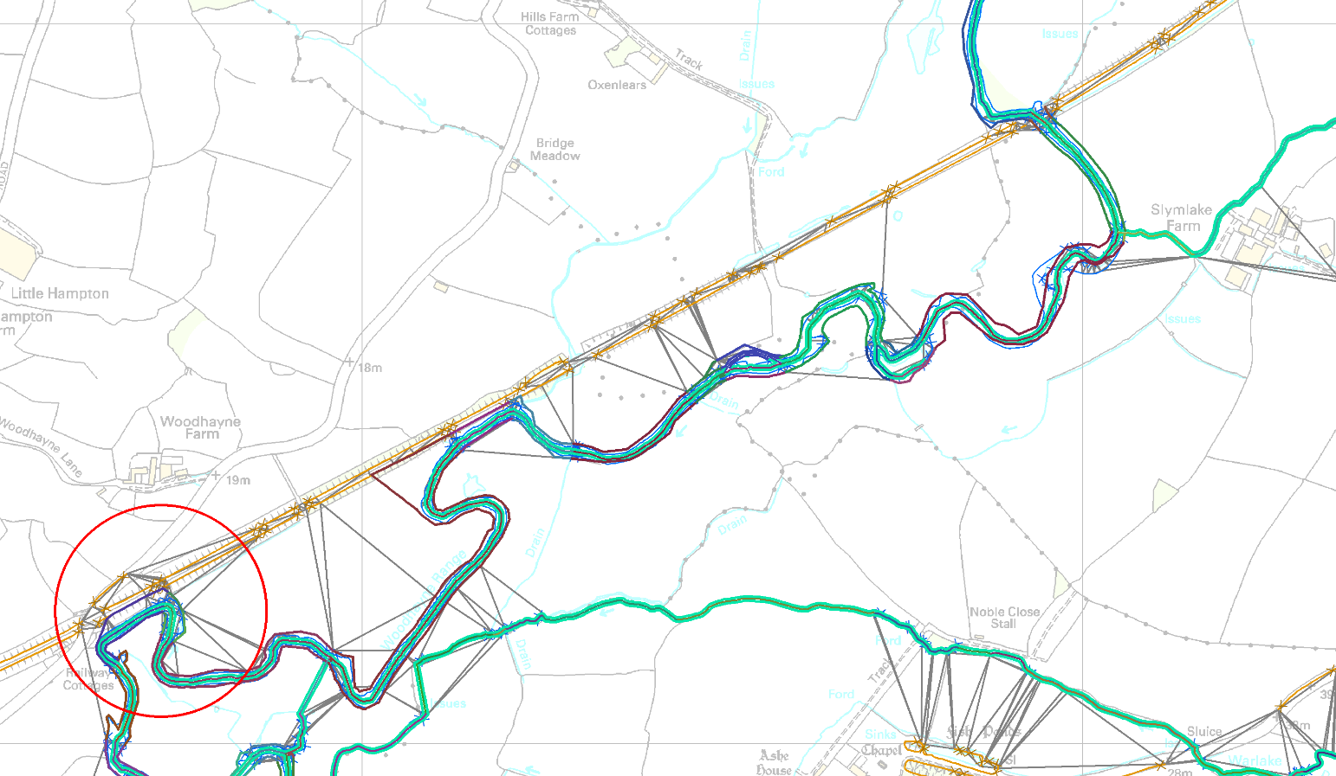
Connecting the features
First we split each low priority feature (e.g. bank line) at the points nearest the ends of higher priority features (e.g. defences)
(using PointOnLineOverlayer with grouping).
This ensures that a long piece of bank does not prevent the route from joining the defence
Then we produce TIN using TINGenerator
This works on points, so we use the line endpoints
We remove TIN edges that cross the defence lines or rivers (and the longest ones on hull)

Slide 21
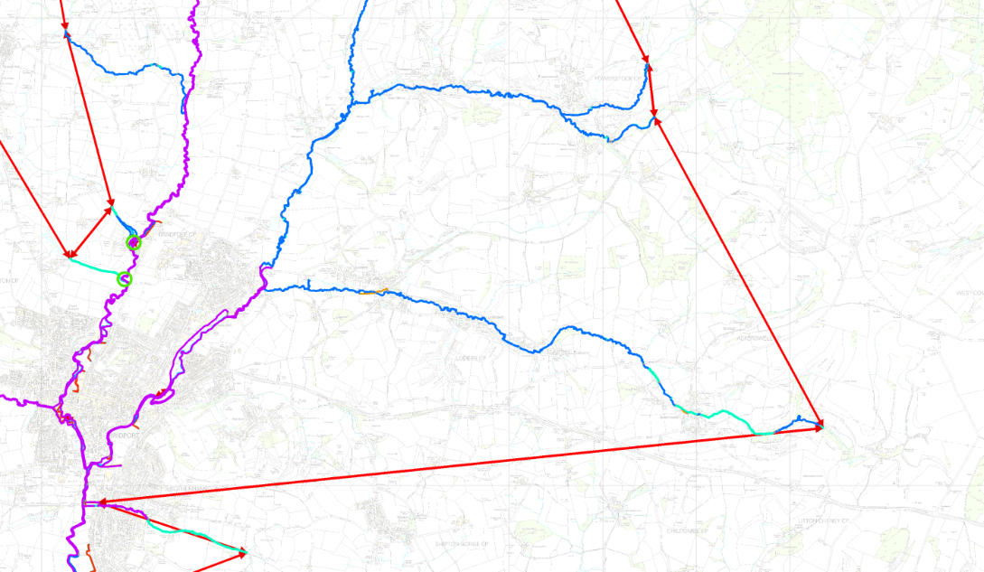
Creating the Continuous Defence Line
Once we’ve made a connected network creating the CDL is simply a matter of running the ShortestPathFinder with appropriate weights
We put a low weight on the defence features we want to use and a high weight on those we want to avoid if possible (the connectors).
We adjust those weights so that the connectors joining high-priority features themselves are also lower weight.
We use the shortest path finder to find routes
“From” the top of each river reach / bank (each source location)
Down to the next confluence or the coast
Along and back up the next reach

Slide 22
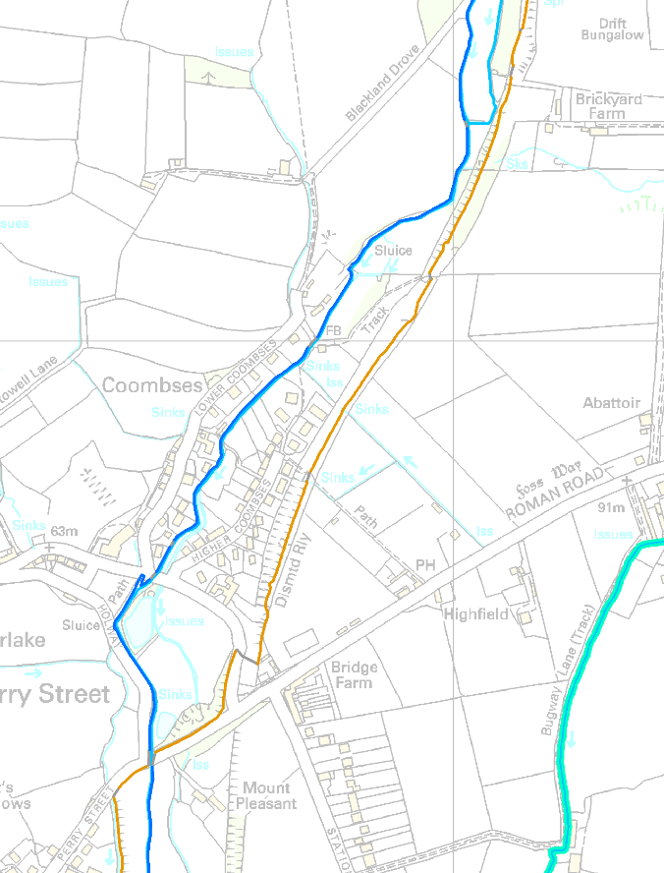
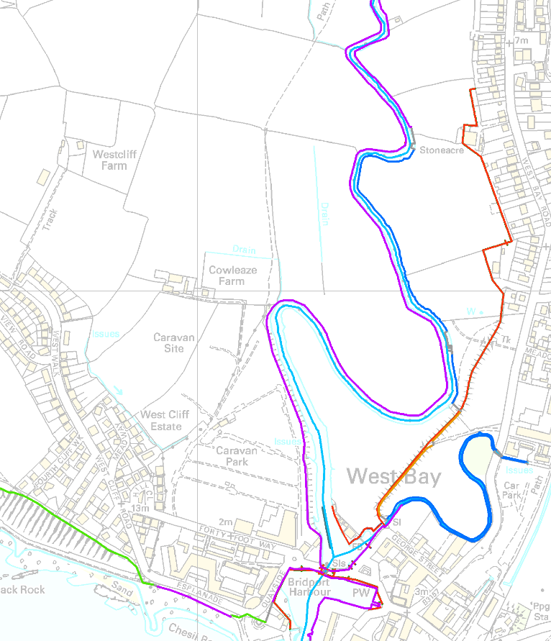
Getting it right
We can never get it completely right automatically!
There are areas with multiple defences, different priorities needed, etc.
There are times when the weighting strategy needs adjustment
But, if the wrong features are used then all the user has to do is adjust weights up or down on the intermediate networked data, and re-run.

Slide 23
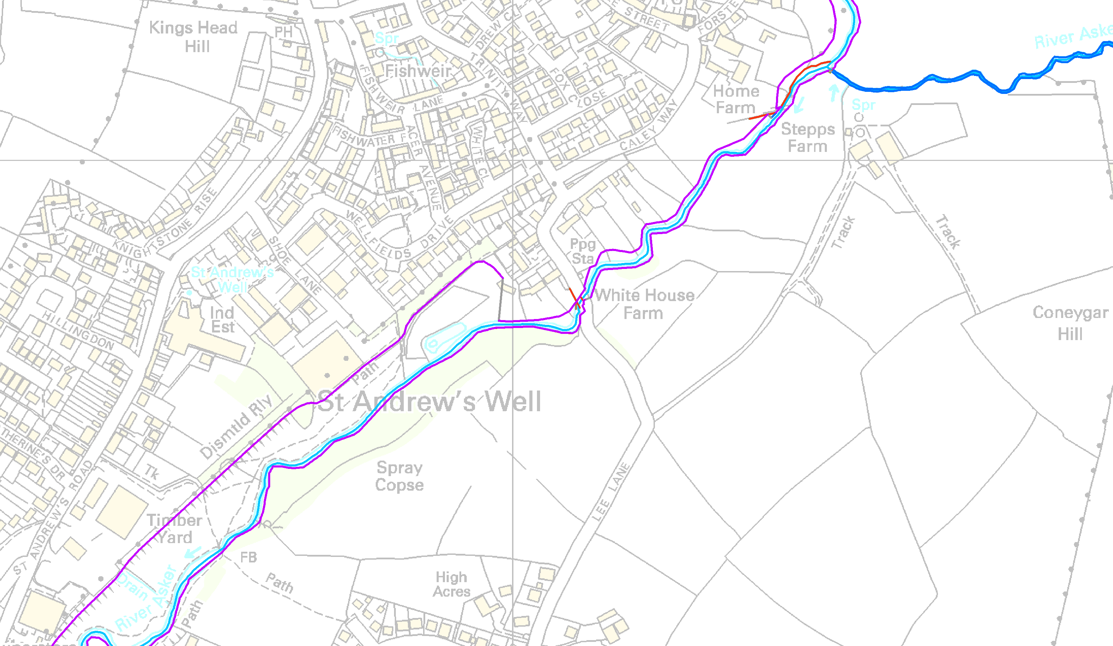
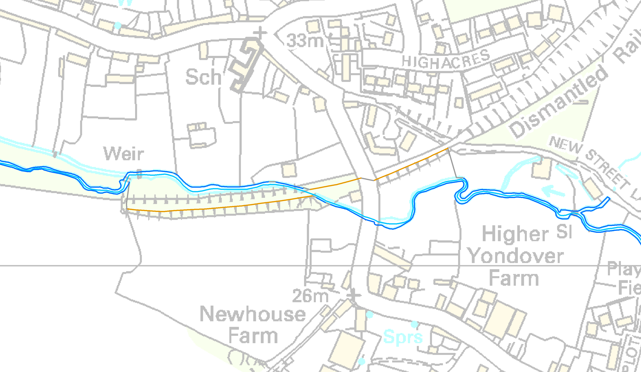
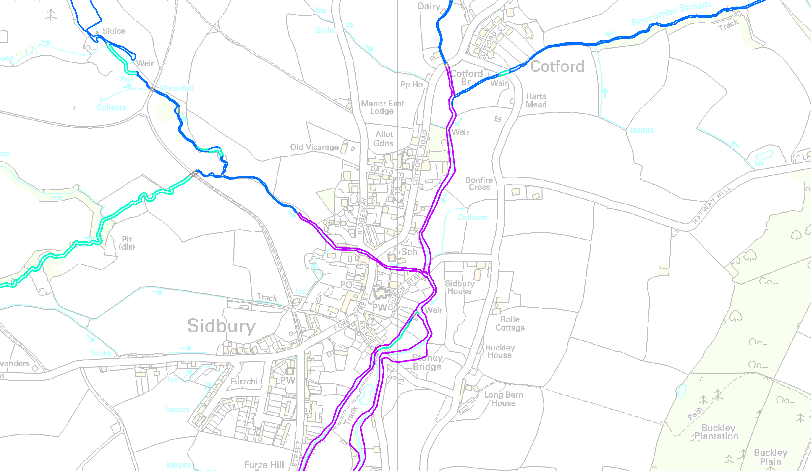
The CDL
The final line smoothly integrates the defence data where it exists, and sensible alternatives elsewhere
However the majority of the time the method processes and selects the correct data
Where “correct” means that the local experts agree it is a good representation of a model they’d have produced manually
And across the catchment a high proportion of the total length of flood defences is incorporated

Slide 24
FME: What’s good
It’s not just about converting data(!)
The geographic processing you can do is extremely advanced.
It’s a cliché, but really, almost everything has been thought of (LeftRightSpatialCalculator!)
We have not thought of a single fundamental operation or test through this project that wasn’t already implemented in a standard transformer
The speed – when you hold its hand and set things up right
The repeatability
The close coupling between an idea and a working process: if you can write it down or draw it, you can FME it

Slide 25
Problems encountered
Occasional strange behaviour with spatial matching – e.g. one feature goes through two paths, then they don’t match. Floating point precision issue?
Some hard-to-duplicate bugs where the FME process itself silently crashes
TINGenerator with grouping is the prime example
Workbench / transformer versions: changes in behaviour and backwards compatibility.
Version control: lack of this is by far the biggest barrier to a “coding” project of this scale with FME.
Without it a workbench can essentially only be developed in one place by one person and these ones are at the limit of what one person can do!
Please, please can this become possible. We would never dream of managing this amount of C# code without it.
Speed – FME is lightning fast when it is set right but some obscure things really matter: spatial tests without grouping; ordering of readers… it would be nice if this could be smarter

Slide 26

Thank you!
This work was funded by the Environment Agency
The project is being undertaken in collaboration with JBA Consulting
h.gibson@hrwallingford.com / 01491 822428

